Slide 1
Coursera Capstone : Bakery in Paris region

Slide 2
Business problem
Find an optimal location for a new bakery in Paris Region
Paris suburb is full of existing bakeries.
Other venues can sell bread and pastries, like supermarkets,…
Who is interested ?
Investors, to invest on a right place
Future manager of the bakery, to have good sales.
Public managers (mayor), to convince investor to open a new bakery in their town

Slide 3
Methodology
Find all existing bakeries in Paris Region
Using Foursquare API
Filtering by « bakery » venue
Foursquare answer is 50 venues maximum, so create a grid of location and interrogate foursquare on each location.
Analysing by visualizing all bakeries
Using folium and heatmap
Define a promising region
Filter on every location of the promising region
Define a point every 300 m
Calculate distance if the nearest bakery for each point.
Filter the points with nearest bakery > 500m
Cluster all resulting points to find candidates locations.
Using Scikit Learn and k-means clustering

Slide 4
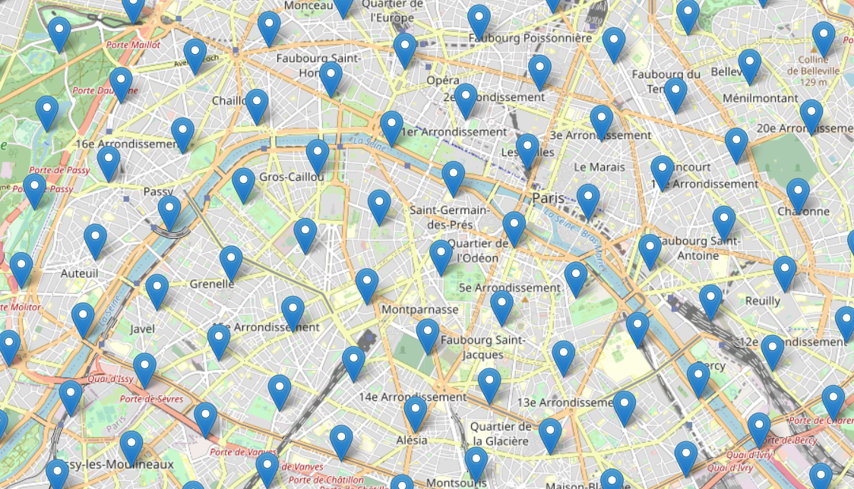
Data – Foursquare interrogation
Creating a grid of points within 15km form paris city centre, separated by 1000 m
Interrogating Foursquare about bakeries within 1000m of each point.
Adding all results in a dictionnary to avoid duplicates.

Slide 5
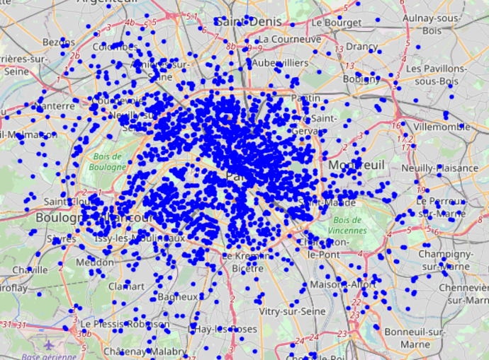
Data – Foursquare bakeries
Venues that are bakeries or bakeries-like.
2 821 venues in the area

Slide 6
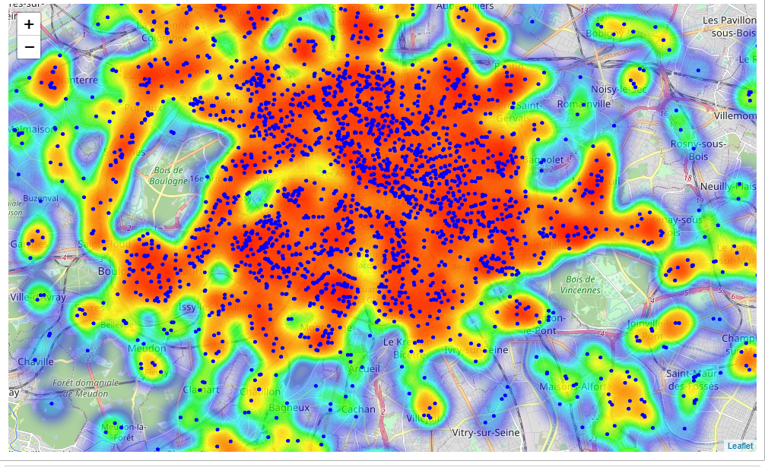
Analysing – bakeries locations
Heatmap shows high density and low density bakeries neighborhoods in Paris and suburb
Most of bakeries are in Paris City
High density is in the west suburb, east suburb and south-west ( Boulogne)
South suburb of Paris seems to be a low density zone.

Slide 7
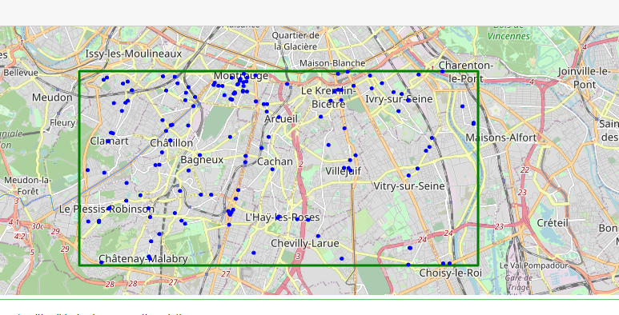
Analysing – restricting to the south suburb
Restricting to the south suburb.
Low density of bakeries.
High density of population

Slide 8
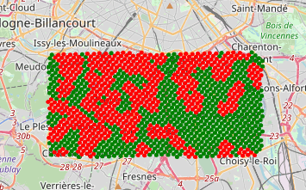
Analysing – interesting points.
Within the region
Create points each 300 m
Calculate nearest bakery for each point
Filter the points with no bakery within the 500m
Green points : nearest bakery >= 500m
Red points : nearest bakery < 500m

Slide 9
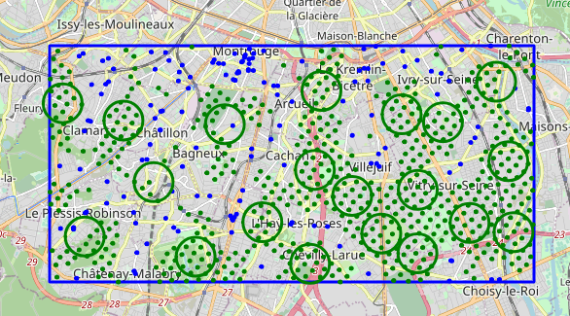
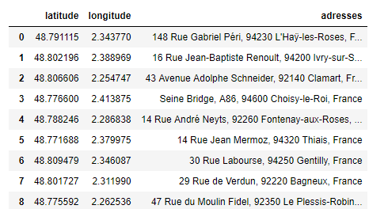
Analysing – clustering points.
Points with no bakery within 500m
K-means clustering (scikit learn)
20 clusters defined.
Adress calculated for each cluster
Google geocode API

Slide 10
Conclusion
20 adresses obtained, with fulfilled criteria
In south suburb
With no bakery within 500m
Theses addresses have to be further analysed with other criteria:
Attractiveness, proximity of roads or railway station;
Population

